Slide 1

AI Chatbot for Life Sciences Research: Powered by Retrieval-Augmented Generation
Presented by: Venkata Mani Sivasai Shanmukha Rajendra Goparaju

Slide 2


Problem Statement
Researchers struggle to quickly find relevant information from large volumes of research papers, articles, and data.
This time-consuming process delays decision-making and slows research progress.

Slide 3
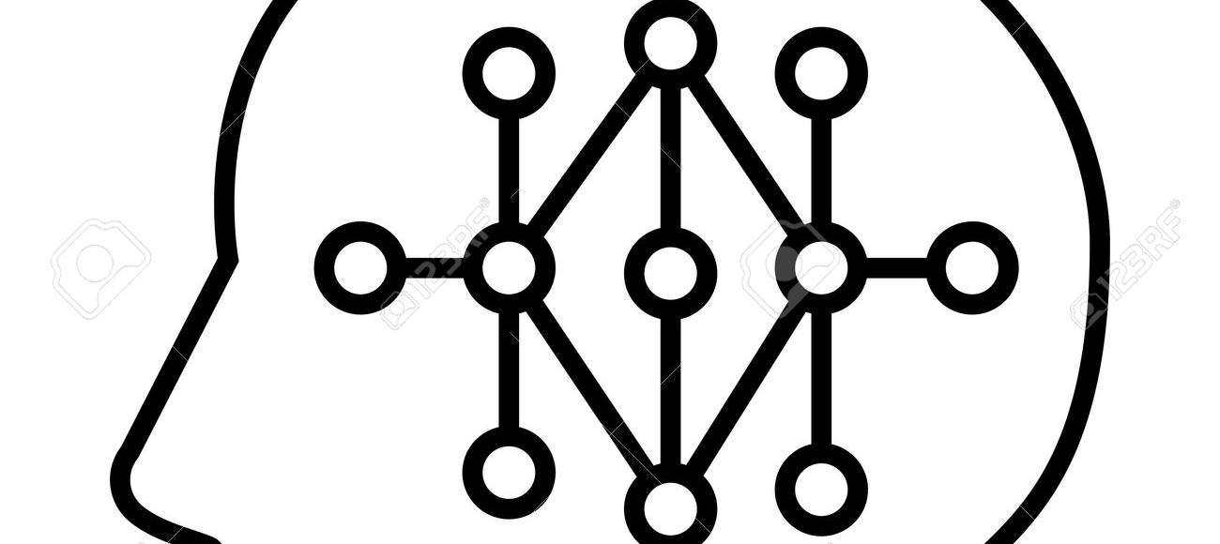

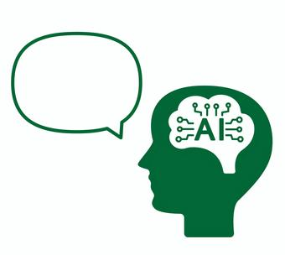
Solution Overview
An AI-powered chatbot that answers life sciences research questions using Retrieval-Augmented Generation (RAG).
It retrieves relevant data from a knowledge base and generates accurate, context-aware responses.

Slide 4
High-Level System Description
Develop an AI-powered chatbot to help life sciences researchers by quickly answering research-related queries using Retrieval-Augmented Generation (RAG).
Input: A user query related to life sciences research (e.g., 'What is CRISPR?' or 'How does gene editing work?')."
Output: A contextually accurate, AI-generated answer based on the retrieved data from research papers, articles, and other scientific resources.

Slide 5



Technical Problem Formulation
Problem:
Process of searching, retrieving, and synthesizing data from scientific literature is manual, slow, and often inaccurate.
Input:
Research-related question (e.g., "What is CRISPR?").
Key Features:
PubMed API: Retrieves relevant papers and abstracts from the PubMed database.
DPR Embeddings: Queries and documents into semantic embeddings for efficient retrieval.
Cosine Similarity: Matches query embeddings with document embeddings to find the top N relevant papers.
Generative Model (OpenAI): Summarizes and generates a concise, context-aware answer based on the retrieved documents.
Output:
Context-aware and summarized response based on the most relevant research papers retrieved.
Dataset:
Source: PubMed API, a vast collection of life sciences research papers.

Slide 6
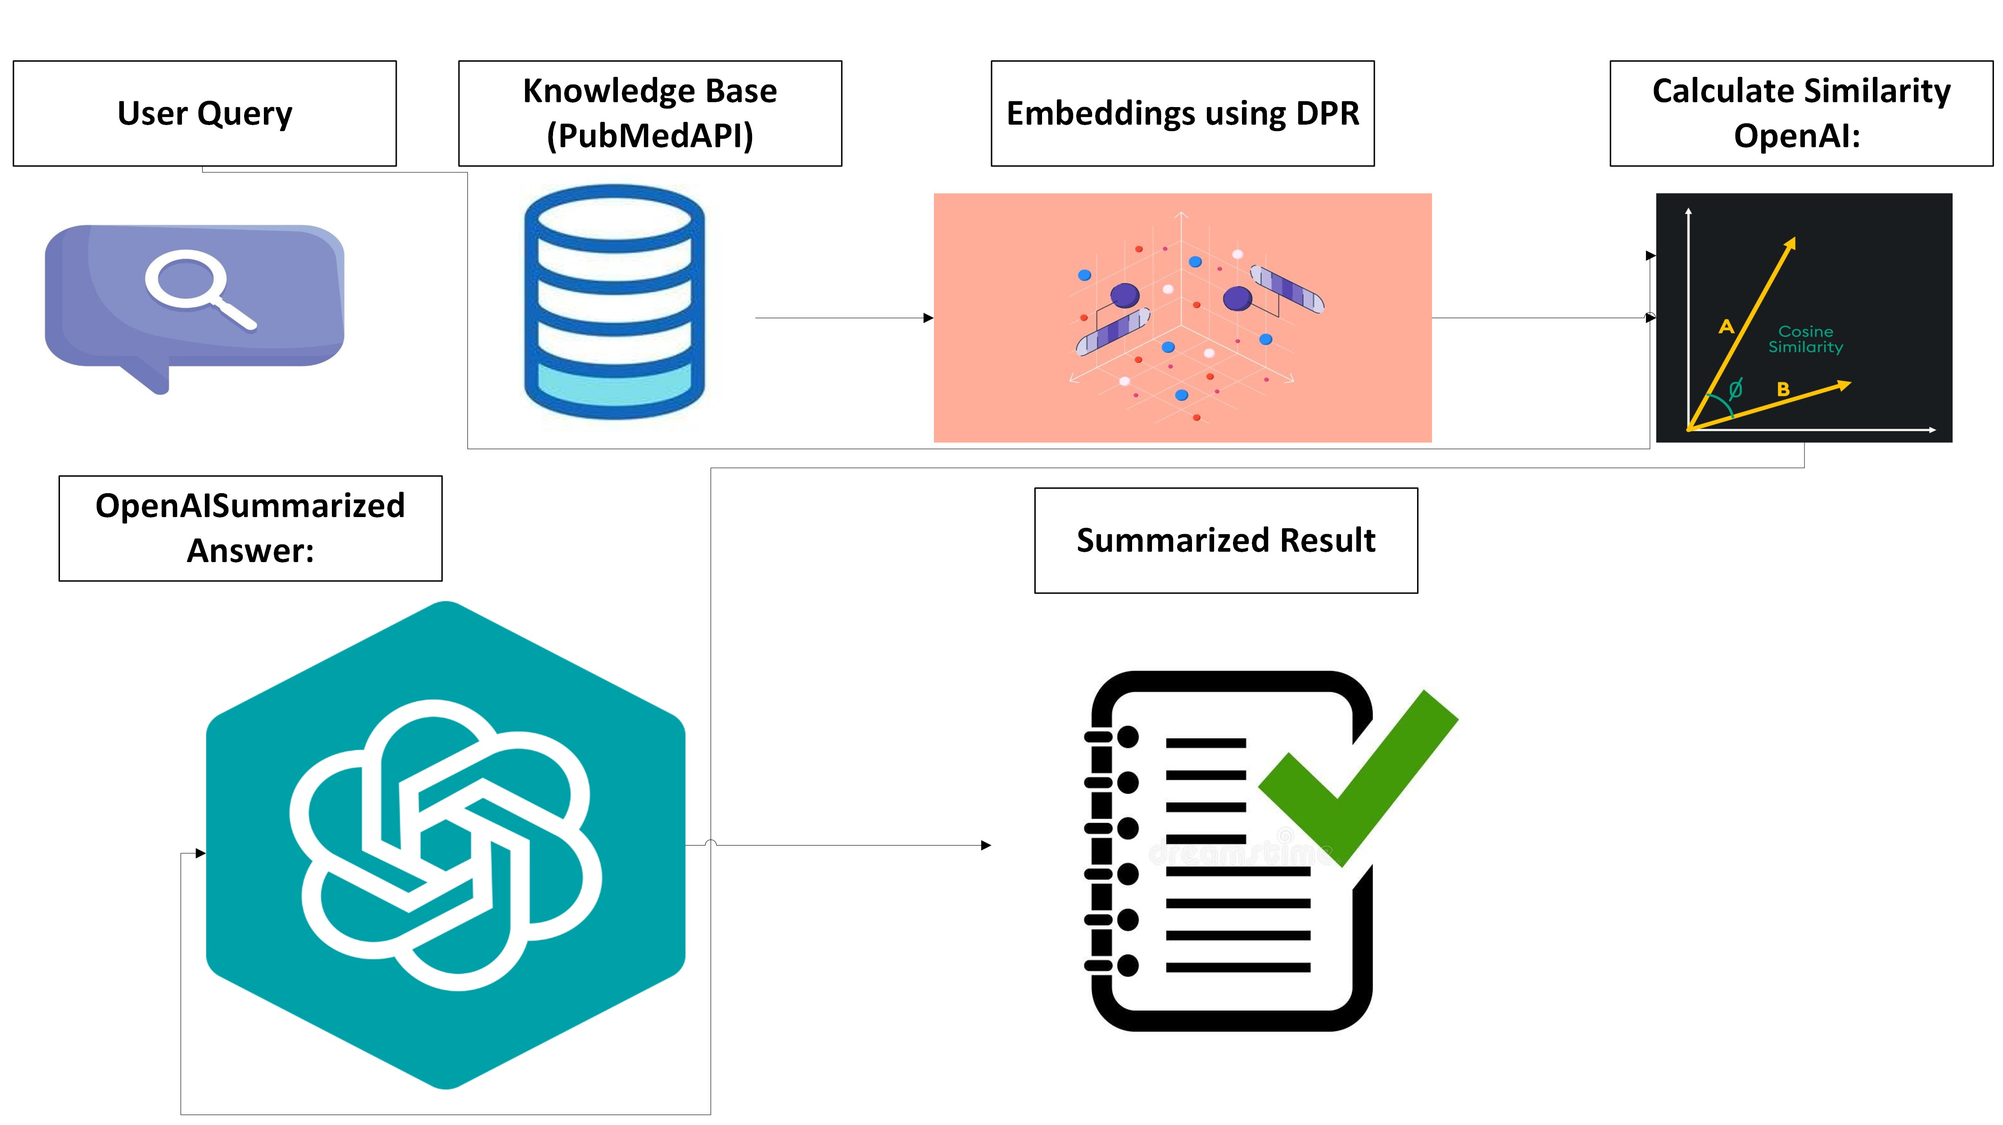
System Architecture

Slide 7
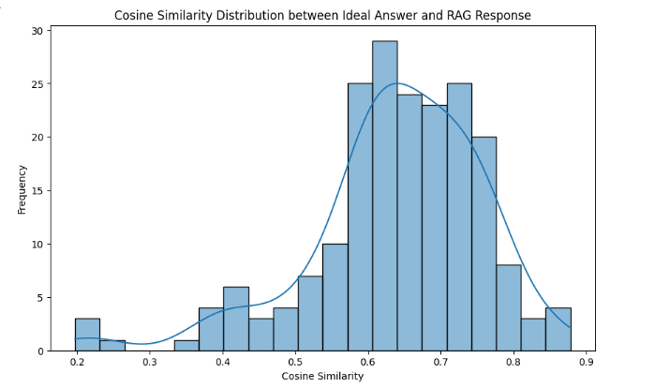
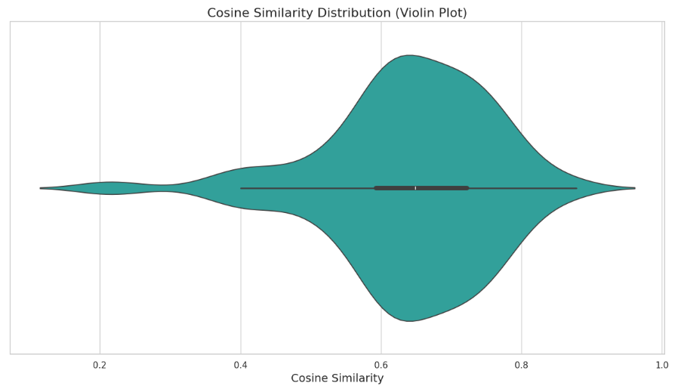
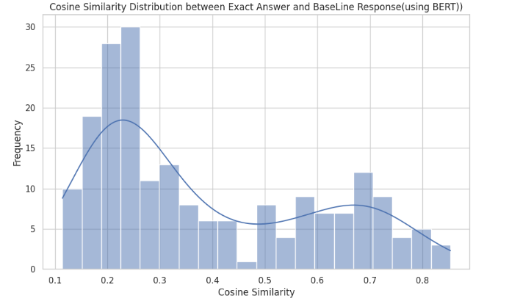
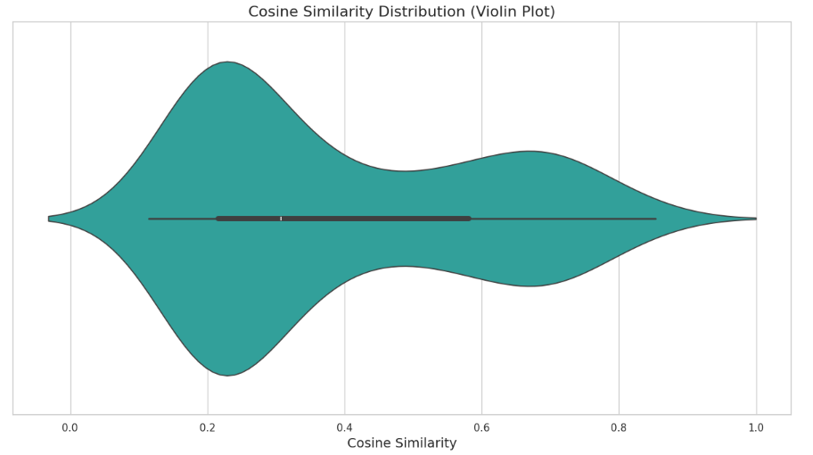
Results
Similarity Comparison: RAG vs BERT (Baseline)
Similarity Comparison: RAG vs BERT (Baseline)​
RAG
BERT

Slide 8
Conclusion
RAG improved retrieval and summarization of life sciences queries, outperforming BERT.
The system significantly boosts response times and accuracy in retrieving relevant research.
Large-Scale Dataset Training: Train the model on large-scale datasets covering a wider range of life sciences research problems and solutions
User Feedback: Integrate user feedback for continuous learning and better context-aware responses.
Scalability: Extend the system to handle larger datasets and support more advanced queries.
Real-time Integration: Develop real-time integration with life sciences databases for up-to-date information retrieval.
Future Directions

